Slide 1
C++ Programming:
From Problem Analysis to Program Design, Third Edition
Chapter 4: Control Structures I (Selection)

Slide 2
Objectives
In this chapter you will:
Learn about control structures
Examine relational and logical operators
Explore how to form and evaluate logical (Boolean) expressions
Discover how to use the selection control structures if, if...else, and switch in a program
C++ Programming: From Problem Analysis to Program Design, Third Edition

Slide 3
Control Structures
A computer can proceed:
  In sequence
  Selectively (branch) - making a choice
  Repetitively (iteratively) - looping
Some statements are executed only if certain conditions are met
A condition is represented by a logical (Boolean) expression that can be true or false
A condition is met if it evaluates to true
C++ Programming: From Problem Analysis to Program Design, Third Edition

Slide 4
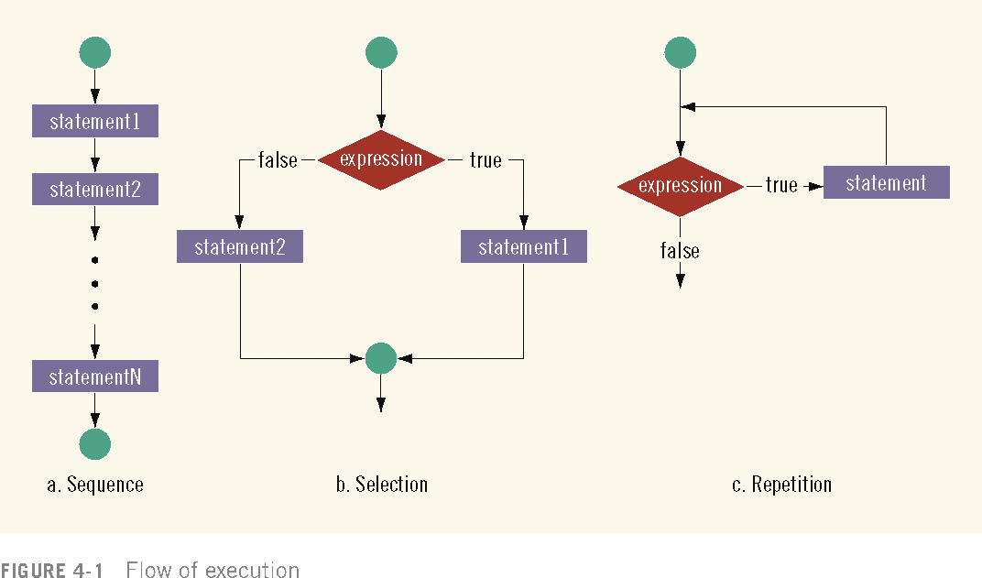

Slide 5
Relational Operators
Relational operators:
  Allow comparisons
  Require two operands (binary)
  Return 1 if expression is true, 0 otherwise
Comparing values of different data types may produce unpredictable results
  For example, 8 < '5' should not be done
Any nonzero value is treated as true
C++ Programming: From Problem Analysis to Program Design, Third Edition

Slide 6
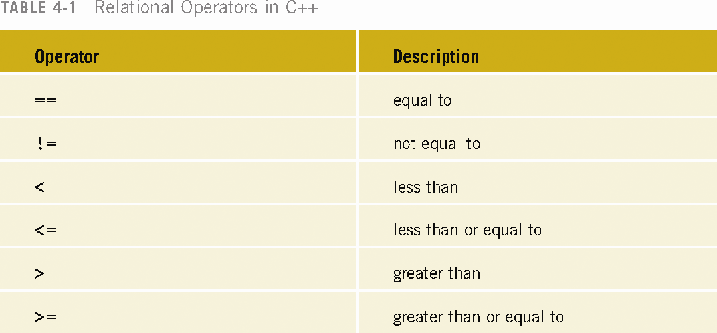

Slide 7
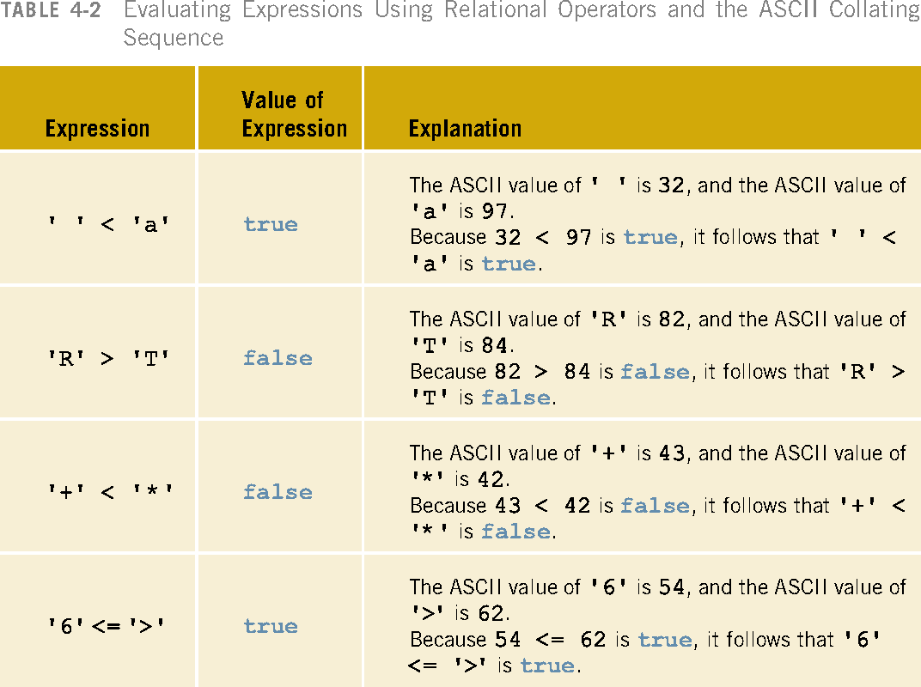

Slide 8
Comparing string Types
Relational operators can be applied to strings
Strings are compared character by character, starting with the first character
Comparison continues until either a mismatch is found or all characters are found equal
If two strings of different lengths are compared and the comparison is equal to the last character of the shorter string
  The shorter string is less than the larger string
C++ Programming: From Problem Analysis to Program Design, Third Edition

Slide 9
string Comparison Example
Suppose we have the following declarations:
  string str1 = "Hello";
  string str2 = "Hi";
  string str3 = "Air";
  string str4 = "Bill";
C++ Programming: From Problem Analysis to Program Design, Third Edition

Slide 10
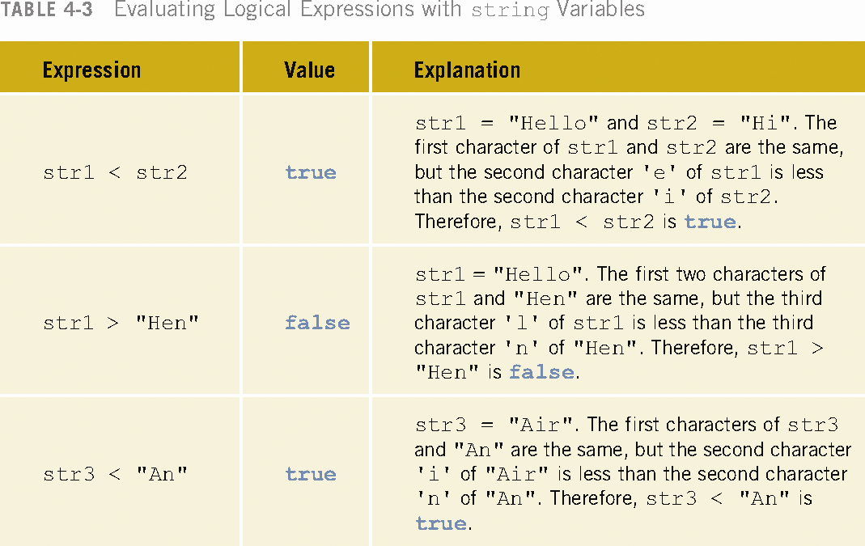

Slide 11
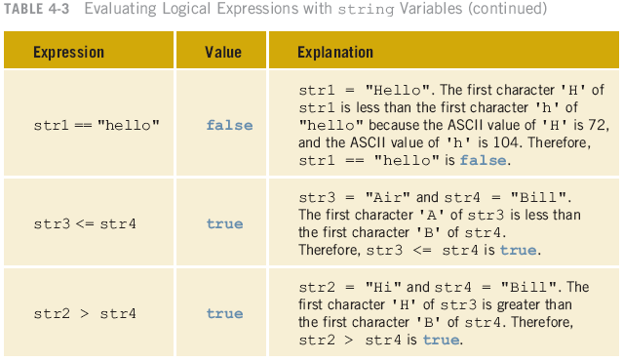

Slide 12
Logical (Boolean) Operators
Logical (Boolean) operators enable you to combine logical expressions
Three logical (Boolean) operators:
  ! - not
  && – and
  || - or
Logical operators take logical values as operands and yield logical values as results
! is unary; && and || are binary operators
Putting ! in front of a logical expression reverses its value
C++ Programming: From Problem Analysis to Program Design, Third Edition

Slide 13
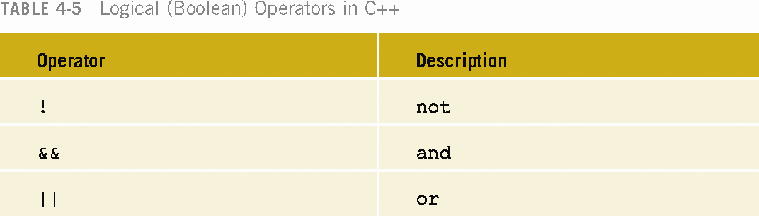

Slide 14
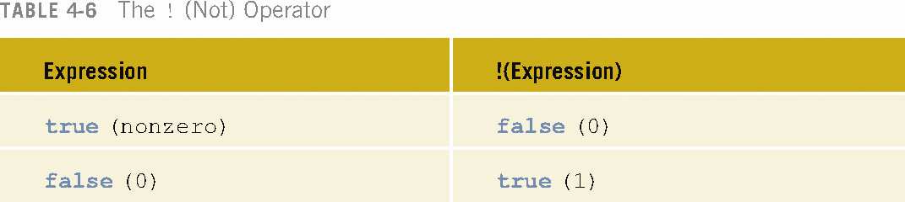
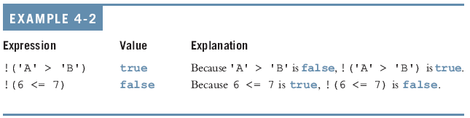

Slide 15
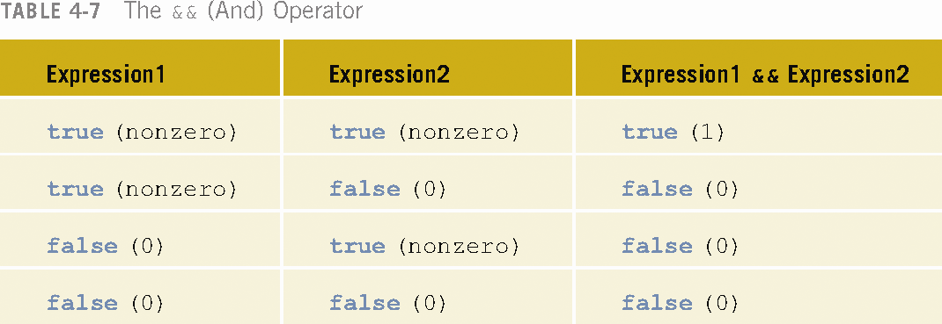
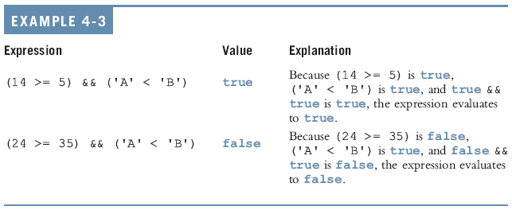

Slide 16
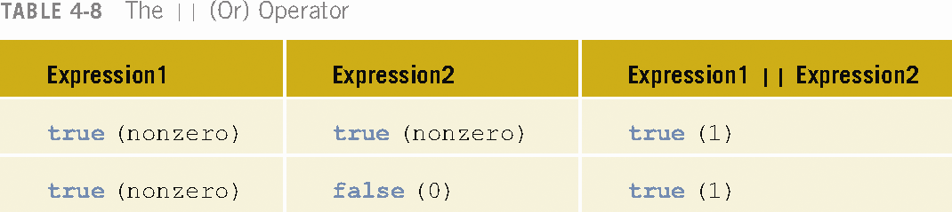

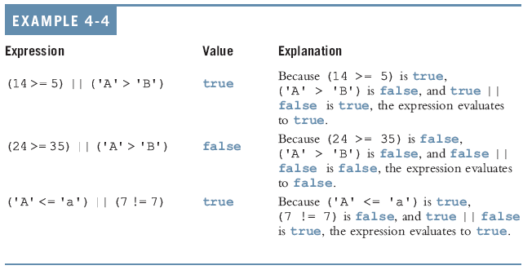

Slide 17
Precedence of Operators
Relational and logical operators are evaluated from left to right
The associativity is left to right
Parentheses can override precedence
C++ Programming: From Problem Analysis to Program Design, Third Edition

Slide 18
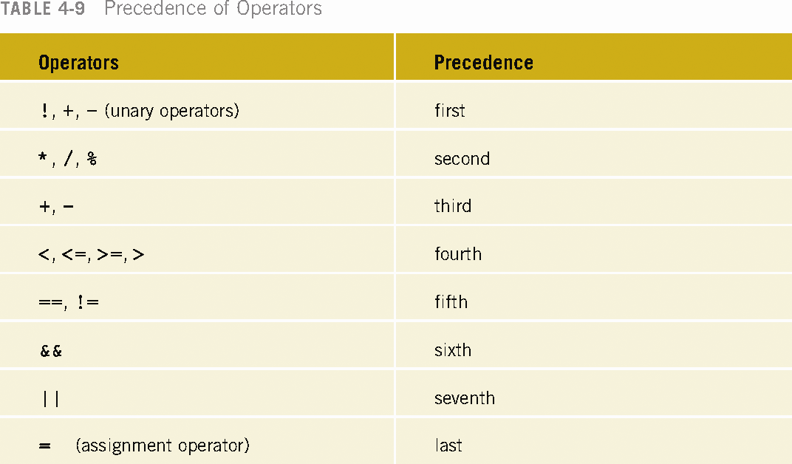

Slide 19
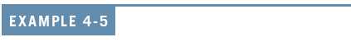
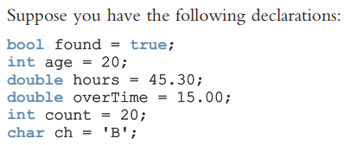

Slide 20
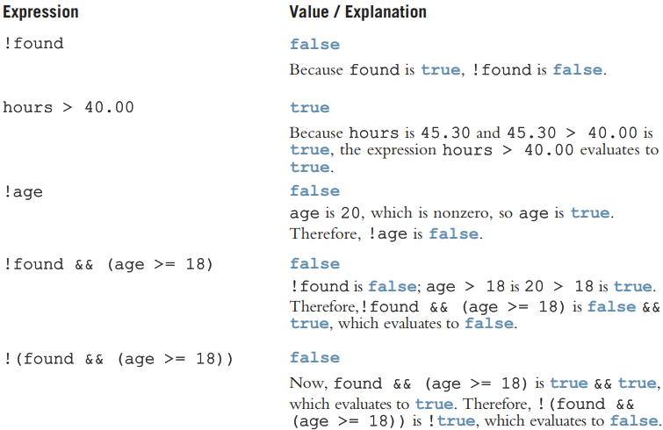
C++ Programming: From Problem Analysis to Program Design, Third Edition

Slide 21
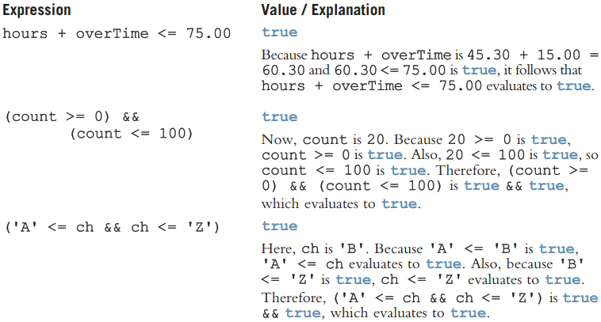
C++ Programming: From Problem Analysis to Program Design, Third Edition

Slide 22
Logical (Boolean) Expressions (continued)
Logical expressions can be unpredictable
The following expression appears to represent a comparison of 0, num, and 10:
For num = 1
0 <= num <= 10
It always evaluates true because 0 <= num evaluates to either 0 or 1, and 0 <= 10 is true and 1 <= 10 is true
A correct way to write this expression is:
0 <= num && num <= 10
C++ Programming: From Problem Analysis to Program Design, Third Edition

Slide 23
One-Way (if) Selection
The syntax of one-way selection is:
if (expression)
statement
Statement is executed if the value of the expression is true
Statement is bypassed if the value is false; program goes to the next statement
C++ Programming: From Problem Analysis to Program Design, Third Edition

Slide 24
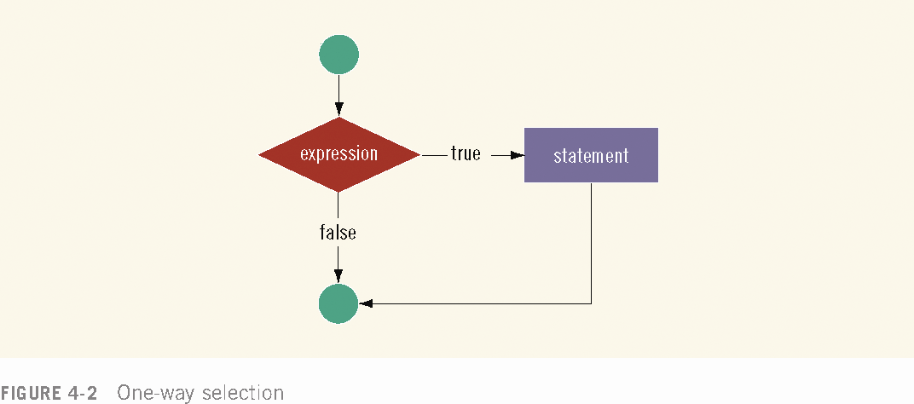

Slide 25
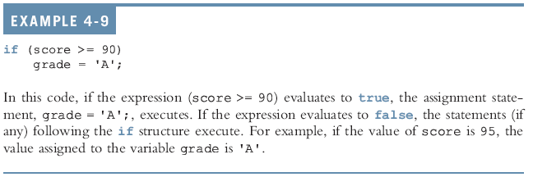

Slide 26
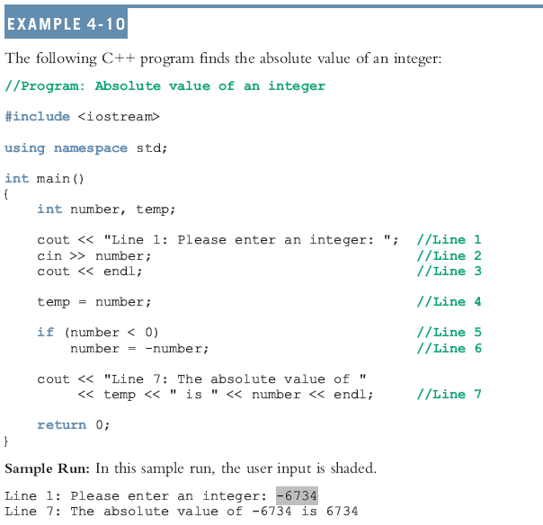

Slide 27
Two-Way (if…else) Selection
Two-way selection takes the form:
if (expression)
statement1
else
statement2
If expression is true, statement1 is executed otherwise statement2 is executed
statement1 and statement2 are any C++ statements
else is a reserved word
C++ Programming: From Problem Analysis to Program Design, Third Edition

Slide 28
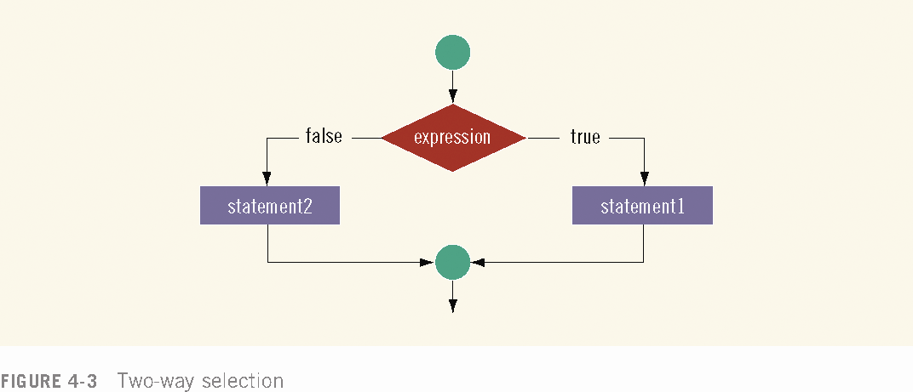

Slide 29
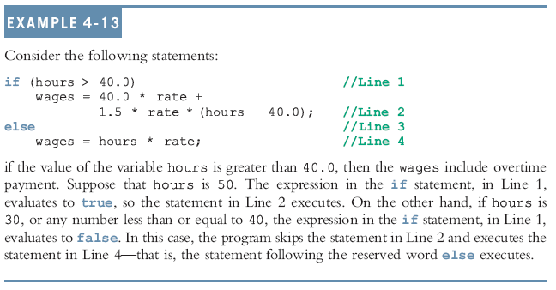

Slide 30
Compound (Block of) Statement
Compound statement (block of statements):
{
statement1;
statement2;
.
.
.
statementn;
}
A compound statement is a single statement
C++ Programming: From Problem Analysis to Program Design, Third Edition

Slide 31
Compound Statement Example
if (age > 18)
{
cout << "Eligible to vote." < <endl;
cout << "No longer a minor." << endl;
}
else
{
cout << "Not eligible to vote.“
<< endl;
cout << "Still a minor." << endl;
}
C++ Programming: From Problem Analysis to Program Design, Third Edition

Slide 32
Nested if
Nesting: one control statement in another
  if (condition1)
  {
  // statements to execute if condition1 is true
  if (condition2)
  {
  // statements to execute if both condition1 and condition2 are true
  }
  }
C++ Programming: From Problem Analysis to Program Design, Third Edition

Slide 33
Determining the season based on the month:
#include <iostream>
using namespace std;
int main() {
int month;
cout << "Enter the month (1-12): ";
cin >> month;
if (month >= 1 && month <= 12) {
if (month >= 3 && month <= 5)
cout << "Spring";
else if (month >= 6 && month <= 8)
cout << "Summer";
else if (month >= 9 && month <= 11)
cout << "Autumn";
else
cout << "Winter";
} else {
cout << "Invalid month entered!";
}
return 0;
}

Slide 34
Checking eligibility for voting:
#include <iostream>
using namespace std;
int main() {
int age;
cout << "Enter your age: ";
cin >> age;
if (age >= 18) {
cout << "You are eligible to vote.";
} else {
cout << "You are not eligible to vote.";
if (age < 0)
cout << " (Age cannot be negative)";
else
cout << " (You need to be 18 or older)";
}
return 0;
}

Slide 35
Finding the largest of three numbers:
#include <iostream>
using namespace std;
int main() {
int num1, num2, num3;
cout << "Enter three numbers: ";
cin >> num1 >> num2 >> num3;
if (num1 >= num2) {
if (num1 >= num3)
cout << "Largest number: " << num1;
else
cout << "Largest number: " << num3;
} else {
if (num2 >= num3)
cout << "Largest number: " << num2;
else
cout << "Largest number: " << num3;
}
return 0;
}

Slide 36
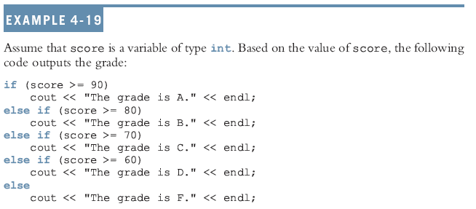
Chained if-else statement
C++ Programming: From Problem Analysis to Program Design, Third Edition

Slide 37
Conditional Operator (?:)
Conditional operator (?:) takes three arguments (ternary)
Syntax for using the conditional operator:
expression1 ? expression2 : expression3
If expression1 is true, the result of the conditional expression is expression2. Otherwise, the result is expression3
Consider the following statements:
  if (a >= b)
  max = a;
  else
  max = b;
You can use the conditional operator to simplify the writing of this if. . .else statement as follows:
max = (a >= b) ? a : b;
C++ Programming: From Problem Analysis to Program Design, Third Edition

Slide 38
switch Structures
switch structure: alternate to if-else
switch expression is evaluated first
Value of the expression determines which corresponding action is taken
Expression is sometimes called the selector
C++ Programming: From Problem Analysis to Program Design, Third Edition

Slide 39
switch Structures (continued)
Expression value can be only integral
Its value determines which statement is selected for execution
A particular case value should appear only once
C++ Programming: From Problem Analysis to Program Design, Third Edition

Slide 40
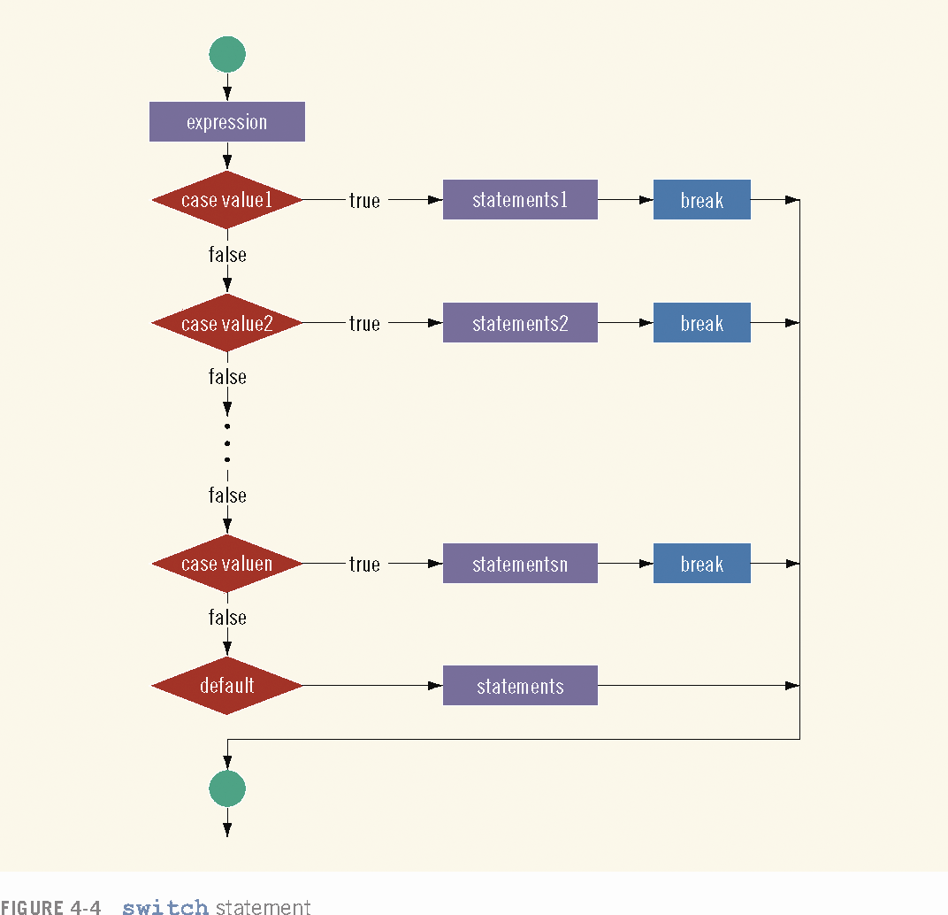

Slide 41
switch Structures (continued)
One or more statements may follow a case label
Braces are not needed to turn multiple statements into a single compound statement
The break statement may or may not appear after each statement
switch, case, break, and default are reserved words
C++ Programming: From Problem Analysis to Program Design, Third Edition

Slide 42
#include <iostream>
using namespace std;
int main()
{
char grade;
cout << "Enter your grade: ";
cin >> grade;
switch (grade)
{
case 'A':
      cout << "Your grade is A." << endl;
      break;
      case 'B':
      cout << "Your grade is B." << endl;
      break;
      case 'C':
      cout << "Your grade is C." << endl;
        break;
        case 'F':
        cout << "Your grade is F." << endl;
        break;
        default:
        cout<<" The grade is invalid."<<endl;
}
return 0;
}

Slide 43
// Program to build a simple calculator using switch Statement
#include <iostream>
using namespace std;
int main() {
char oper;
float num1, num2;
cout << "Enter an operator (+, -, *, /): ";
cin >> oper;
cout << "Enter two numbers: " << endl;
cin >> num1 >> num2;
switch (oper) {
case '+':
cout << num1 << " + " << num2 << " = " << num1 + num2;
break;
case '-':
cout << num1 << " - " << num2 << " = " << num1 - num2;
break;
case '*':
cout << num1 << " * " << num2 << " = " << num1 * num2;
break;
case '/':
cout << num1 << " / " << num2 << " = " << num1 / num2;
break;
default:
cout << "Error! The operator is not correct";
break;
}
return 0;
}

Slide 44
// C program to illustrate the use of nested switch
#include <iostream>
using namespace std;
int main()
{
int var1 = 1;
int var2 = 0;
// outer switch
switch (var1) {
case 0:
cout << "Outer Switch Case 0\n";
break;
case 1:
cout << "Outer Switch Case 1\n";
// inner switch
switch (var2) {
case 0:
cout << "Inner Switch Case 0\n";
break;
}
break;
default:
cout << "Default Case of Outer Loop";
break;
}
return 0;
}

Slide 45
// C++ Program to implement Range in Swtich Case
#include<iostream>
using namespace std;
// main function
int main()
{
int a=8;
// Switch Case
switch(a)
{
// Range added to Switch case
case 4 ... 10:
cout<<"a is range 4 to 10"<<endl;
break;
}
}

Slide 46
// C++ Program to implement Range in Swtich Case
#include<iostream>
using namespace std;
// main function
int main()
{
char y='a';
switch(y)
{
case 'a' ... 'c':
cout<<"a ... c";
break;
case 'd' ... 'f':
cout<<"d ... f";
}
}

Slide 47
// Vowel or Constant C++ Program
#include<iostream>
using namespace std;
// main function
int main()
{
char ch;
cout<<“Enter any alphabet : ”;
cin>>ch;
switch(ch)
{
case ‘a’:
case ‘e’:
case ‘I’:
case ‘o’:
case ‘u’:
cout<<“Vowel";
break;
default:
cout<<“Constant";
}
}

Slide 48
C++17 new feature : If Else and Switch Statements with initializers
// Before C++17
int i = 2;
if ( i % 2 == 0)
cout << i << " is even number" << endl;
// After C++17
// if(init-statement; condition)
if (int i = 4; i % 2 == 0 )
cout << i << " is even number" << endl;
// Switch statement
// switch(init;variable)
switch (int i = 100; i) {
default:
cout << "i = " << i << endl; break;
}
C++ Programming: From Problem Analysis to Program Design, Third Edition

Slide 49
Summary
Control structures alter normal control flow
Most common control structures are selection and repetition
Relational operators: ==, <, <=, >, >=, !=
Logical expressions evaluate to 1 (true) or 0 (false)
Logical operators: ! (not), && (and), || (or)
C++ Programming: From Problem Analysis to Program Design, Third Edition

Slide 50
Summary (continued)
Two selection structures: one-way selection and two-way selection
The expression in an if or if...else structure is usually a logical expression
No else statement in C++. Every else has a related if
A sequence of statements enclosed between braces, { and }, is called a compound statement or block of statements
C++ Programming: From Problem Analysis to Program Design, Third Edition

Slide 51
Summary (continued)
Using assignment in place of the equality operator creates a semantic error
switch structure handles multiway selection
break statement ends switch statement
C++ Programming: From Problem Analysis to Program Design, Third Edition

